Slide 1
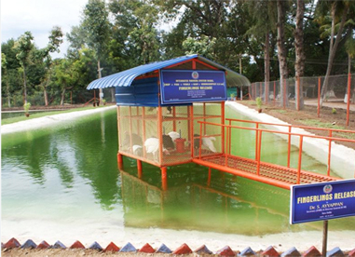

Welcome
to
our
Presentation

Slide 2
Project on
IOT Based Smart Poultry Farm & Fish Farming System

Slide 3

Supervised By
Shipon Tarafdar
Lecturer
Department of CSE
City University

Slide 4

Presented By
Md Al-amin Hossen
1925102523
Department of CSE
City University
Md Anwar Hossain Manik
2115602009
Department of CSE
City University

Slide 5
Introduction
The project introduces an IoT-based smart system for poultry and fish farming integrating sensors and automation to monitor environmental conditions.
The system allows remote monitoring and control via a user-friendly mobile application Improving animal welfare productivity and sustainable practices thereby reducing manual labor.

Slide 6

Problem Statement
To build a smart poultry farm by developing an IOT-based system.
The system provides a food feeder for the chickens, it can manage the temperature to give a water spray mechanism, and it can also minimize undesired gases from poultry through soil moisture.
At the poultry farm a system measures temperature and humidity.

Slide 7
Objective
To enhance productivity and efficiency by providing real-time monitoring and data analytics capabilities for crucial parameters such as temperature, humidity, water quality, and feeding patterns.
To improve resource management by enabling automated control mechanisms for environmental conditions and feeding processes, thereby minimizing wastage and optimizing resource utilization.
To enhance animal welfare by detecting anomalies and health issues early through predictive analytics, facilitating timely intervention and care.

Slide 8
Features
Real-time Monitoring
Automated Control
Remote Access
Alerts and Notifications
Integration Capabilities
Scalability

Slide 9
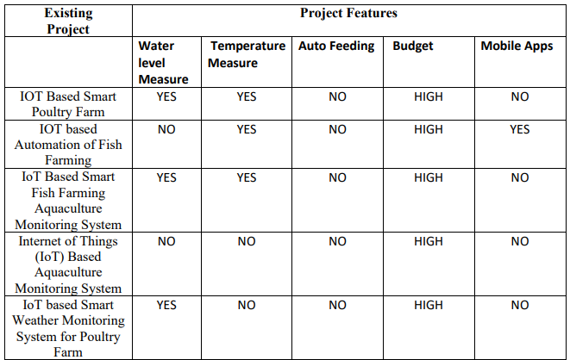
Comparison with previous works

Slide 10
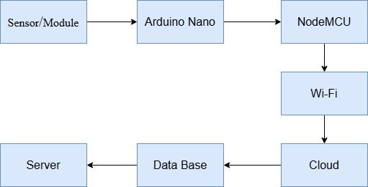
Methodology

Slide 11
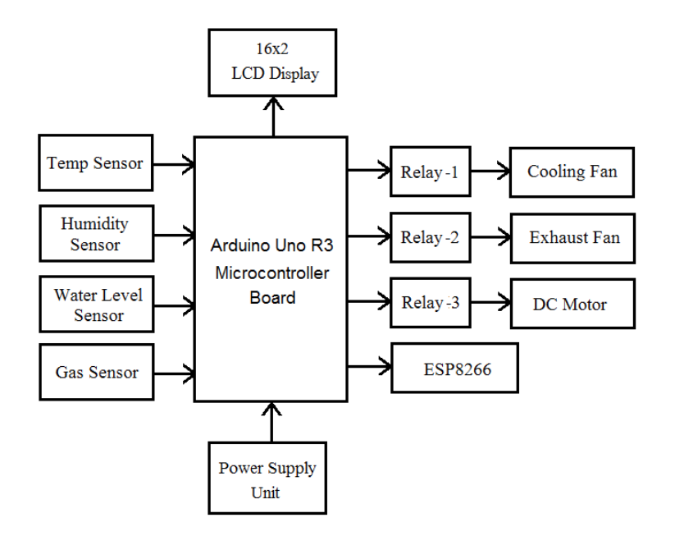
Block Diagram of Proposed System
Bulb

Slide 12
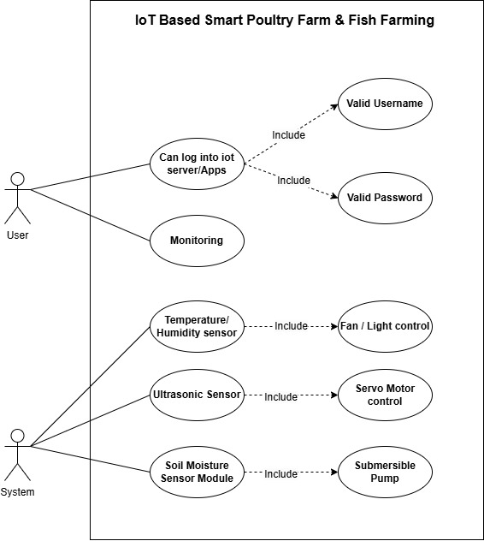
Use Case

Slide 13
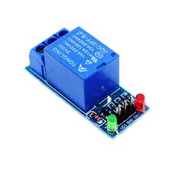
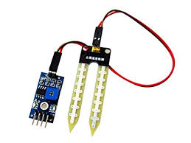
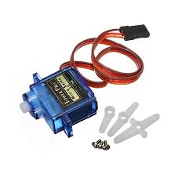

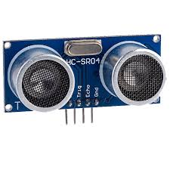
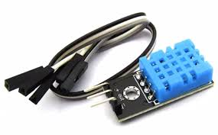
Some Component’s of our Project
Relay Module
Soil moisture sensor
Servo motor
Ultrasonic sensor
Humidity sensor

Slide 14
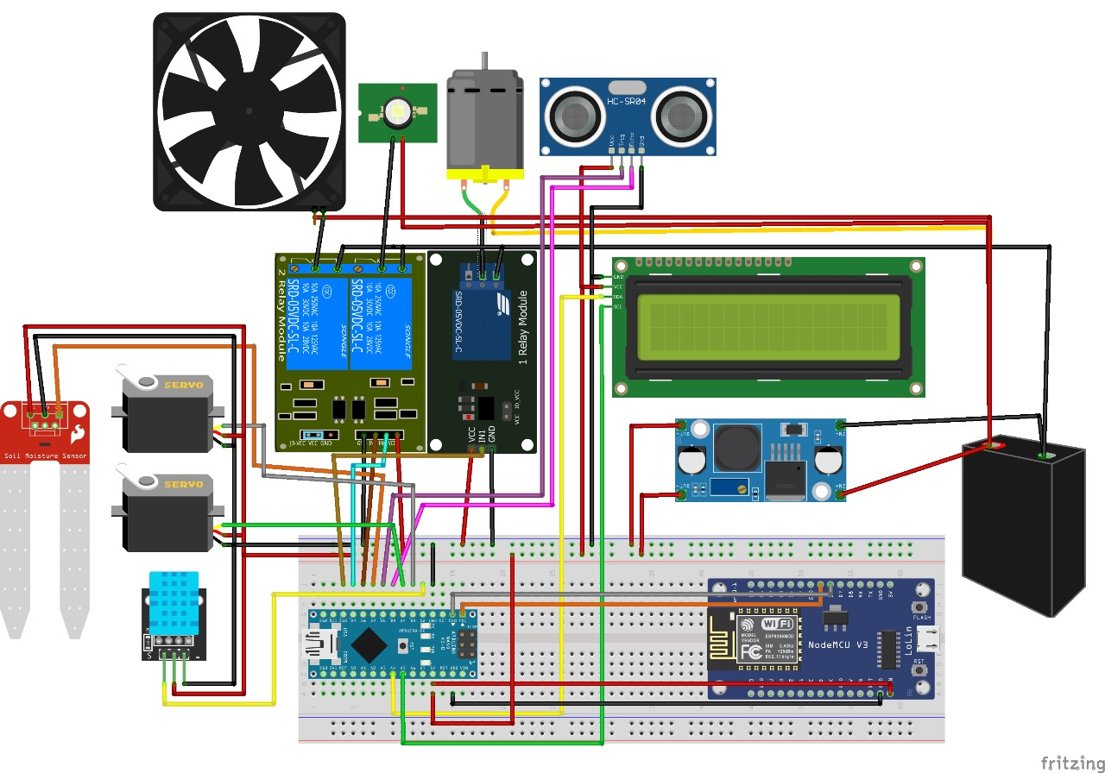
Here’s Our Project Circuit Diagram

Slide 15
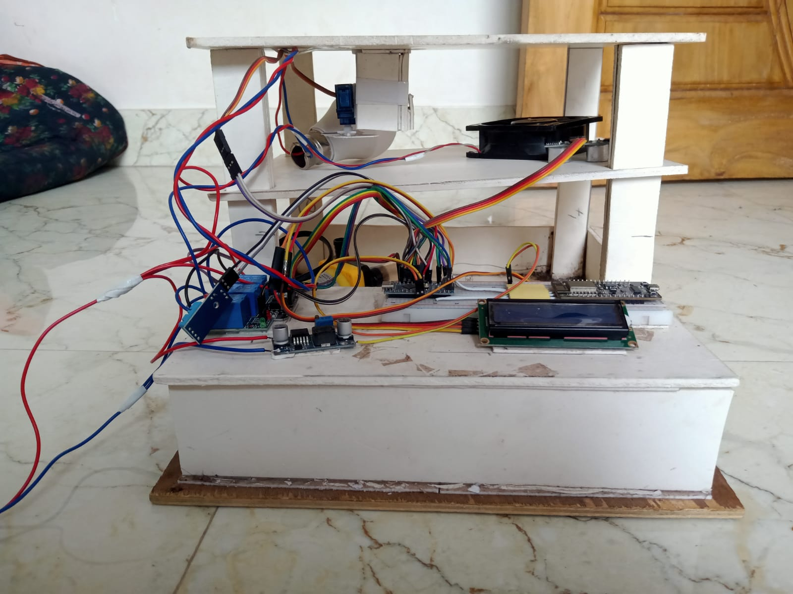
Project Visualization

Slide 16
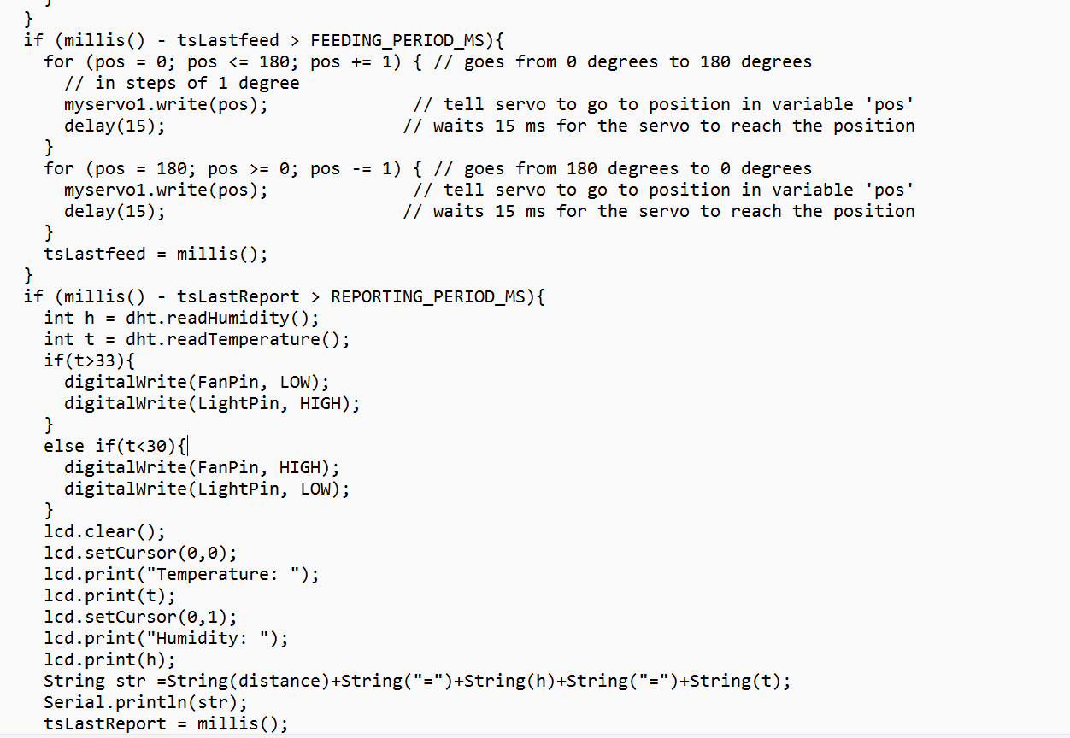
Code

Slide 17
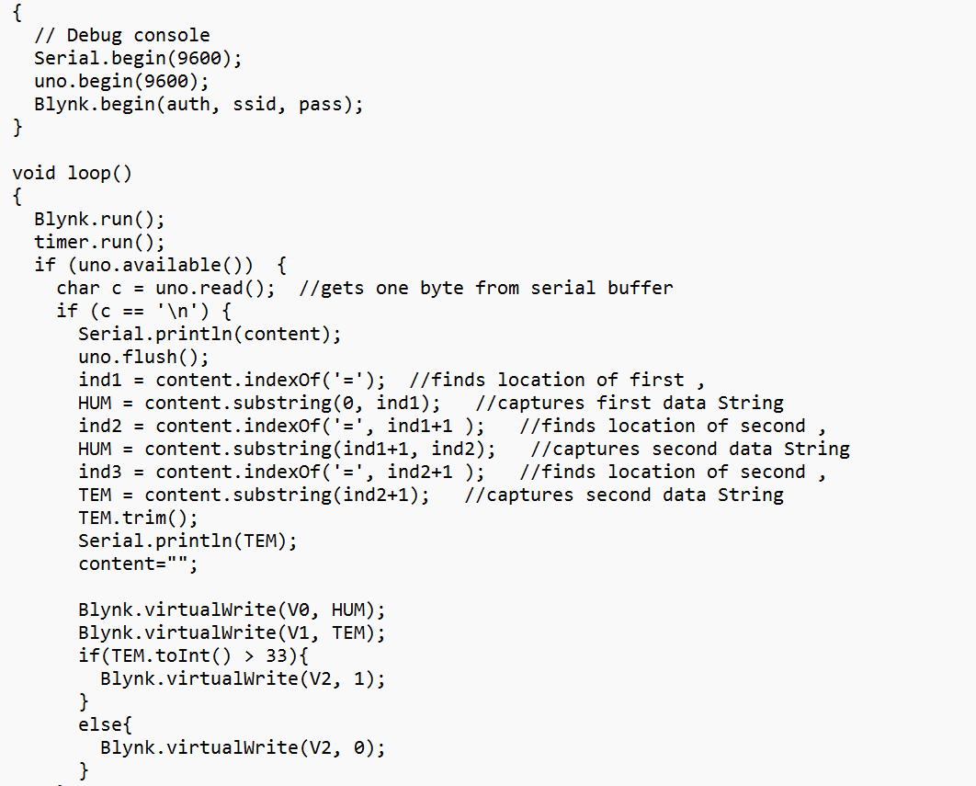
Blynk link Code

Slide 18
Resources
CPU: Dual-core or Higher.
RAM: 1GB.
Hard Disk: 40GB.
Arduino IDE.
Sensor.
Smart Phone.

Slide 19
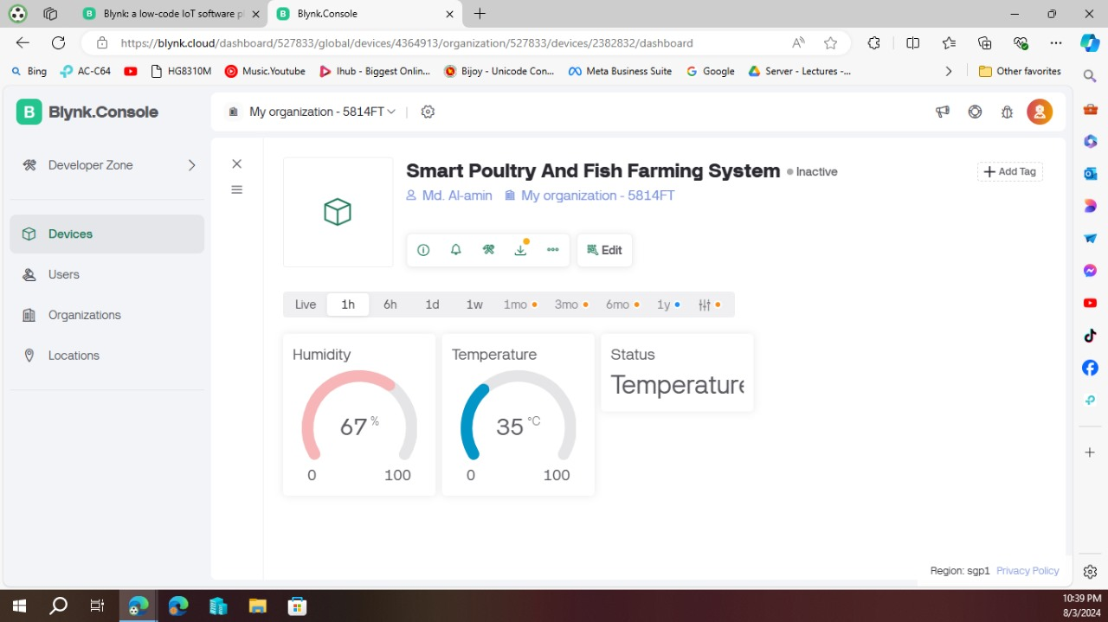
Web Result

Slide 20
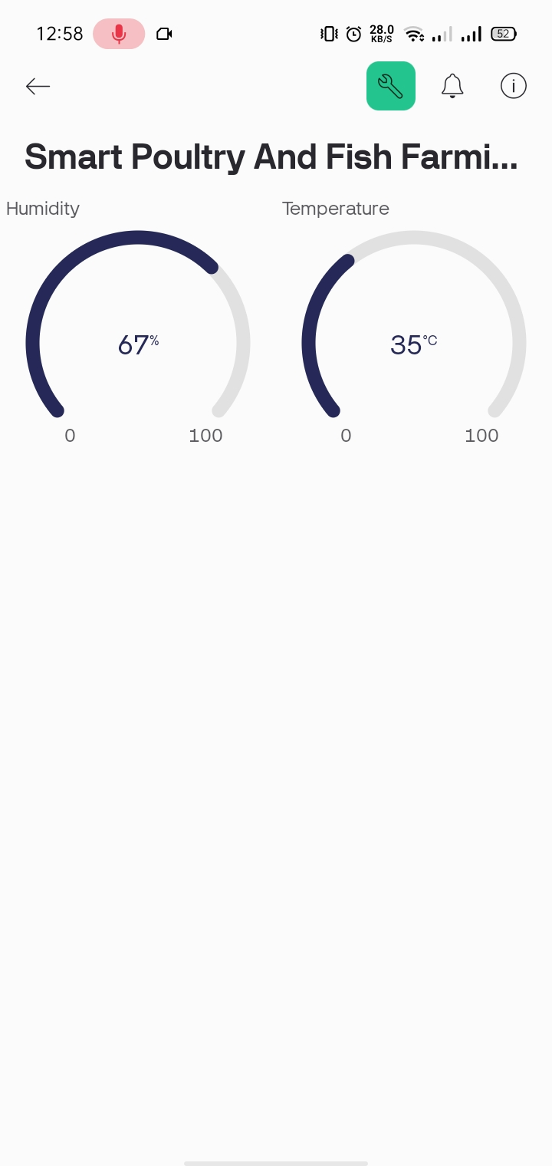
Application Result

Slide 21
Conclusion
An IoT-based smart farming system for poultry and fish farming can improve productivity sustainability and animal welfare by enabling farmers to make informed decisions through real-time monitoring data analytics and automated control mechanisms thereby enhancing operational efficiency.

Slide 22
Thank you

